Slide 1
Chapter 2
Process Models

Slide 2

A Generic Process Model
“A process defines who is doing what , when and how to reach a certain goal. I. Jacobson, G. Booch and J. Rumbaugh

Slide 3

Process Flow

Slide 4
Identifying a Task Set
Each SE action can be represented by a number of different task sets- each a collection of software engineering work tasks, related work products, quality assurance points and project milestones.
A task set defines the actual work to be done to accomplish the objectives of a software engineering action.
  A list of the task to be accomplished
  A list of the work products to be produced
  A list of the quality assurance filters to be applied

Slide 5
Process Patterns
A process pattern
  describes a process-related problem that is encountered during software engineering work,
  identifies the environment in which the problem has been encountered, and
  suggests one or more proven solutions to the problem.
Stated in more general terms, a process pattern provides you with a template [Amb98]—a consistent method for describing problem solutions within the context of the software process.

Slide 6
Process Pattern Types
Stage patterns—defines a problem associated with a framework activity for the process.
Task patterns—defines a problem associated with a software engineering action or work task and relevant to successful software engineering practice
Phase patterns—define the sequence of framework activities that occur with the process, even when the overall flow of activities is iterative in nature.

Slide 7
Process Assessment and Improvement
Standard CMMI Assessment Method for Process Improvement (SCAMPI) — provides a five step process assessment model that incorporates five phases: initiating, diagnosing, establishing, acting and learning.
CMM-Based Appraisal for Internal Process Improvement (CBA IPI)—provides a diagnostic technique for assessing the relative maturity of a software organization; uses the SEI CMM as the basis for the assessment [Dun01]
SPICE—The SPICE (ISO/IEC15504) standard defines a set of requirements for software process assessment. The intent of the standard is to assist organizations in developing an objective evaluation of the efficacy of any defined software process. [ISO08]
ISO 9001:2000 for Software—a generic standard that applies to any organization that wants to improve the overall quality of the products, systems, or services that it provides. Therefore, the standard is directly applicable to software organizations and companies. [Ant06]

Slide 8
Prescriptive Models
Prescriptive process models advocate an orderly approach to software engineering
That leads to a few questions …
If prescriptive process models strive for structure and order, are they inappropriate for a software world that thrives on change?
Yet, if we reject traditional process models (and the order they imply) and replace them with something less structured, do we make it impossible to achieve coordination and coherence in software work?

Slide 9
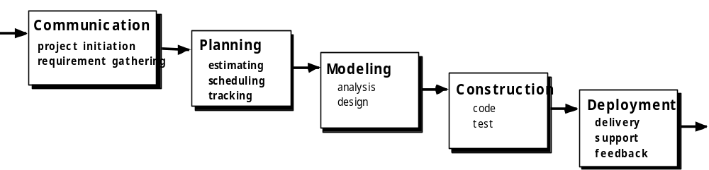
The Waterfall Model
Flow as waterfall
Systematic, sequential approach to software eng.

Slide 10

The V-Model
A variation in the representation of waterfall model
It depicts the relationship of quality assurance actions to the actions associated communication, modelling, and early construction activities.
Practically there is no difference between classical life cycle model and V-model.
V-model visualize how verification and validation actions are applied.

Slide 11
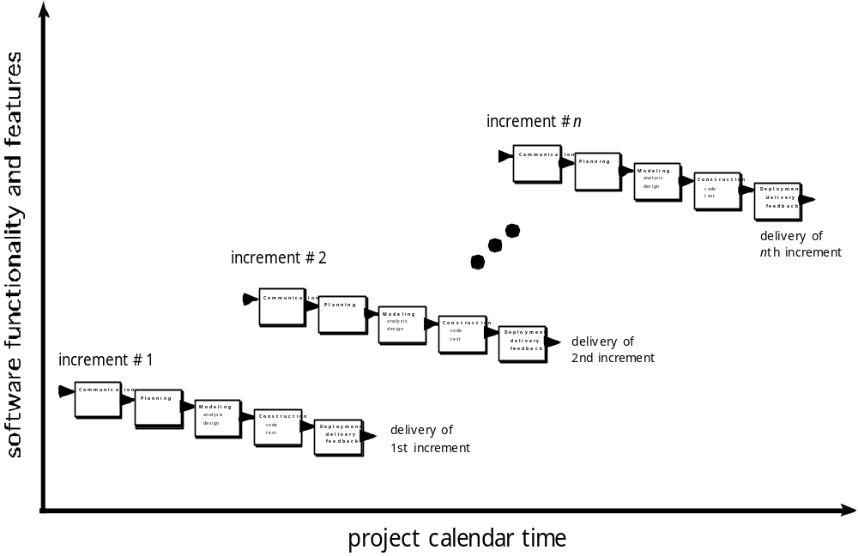
The Incremental Model

